Slide 1
Career Path

Slide 2
Pros and Cons. Discussion
Small and Medium Business (SMB)
Start-ups
Enterprise
Public sector vs Private sector

Slide 3
Slash career
Make you more antifragile
Make your hobbies make money
Help meet your wishes that the current job doesn’t
Examples: HR BP/ Financial consultant, PM/yoga instructor, Sales/University Lecturer

Slide 4
Transforming career
If you want to completely change your role/function
In the same company: easier to show your transferable skills, you already have a reputation etc
Examples: Senior Marketer – Junior PM, HR Director – sales person, Senior Security manager – Junior PM

Slide 5
Capitalization and Monetization
Capitalization – increase your value/price in the market in the long run
Monetization – make the most money now, but can effect your long run price
Trade off
Examples: from Enterprise to Start-up, from local medium company to top Russian company

Slide 6
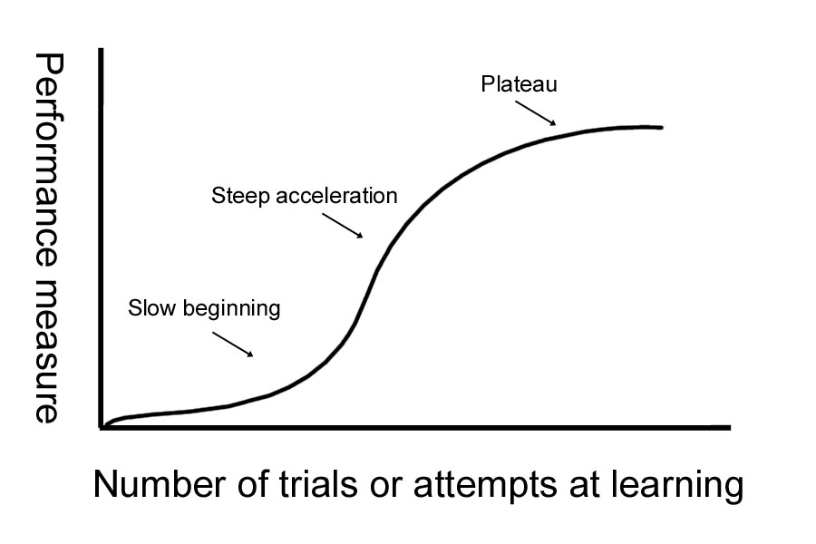
Learning Curve. Key indicator

Slide 7
Career Ladder
Vertical: Junior – middle – senior – team lead – head of dprt
Horizontal: Junior – middle – senior – lead – architect – senior architect
Company level: small local company - medium local company - top Russian company – top international company
Graduate programs

Slide 8

Q&A

